Slide 1
Template Matching And Normalized Cross Correlation
CMPUT 206
Nilanjan Ray

Slide 2
Searching for a patch in an image
How do we look for the small patch (template) in the large image?

Slide 3


Answer: Filter
Also known as correlation in this context!
We already know the formula for it (I is the image, T is the patch/template):
We also know how to compute it: “sliding window dot product”
$$C(i,j)=\sum_{m}{\sum_{n}{I\left(i+m,j+n\right)T(m,n)}}$$
$$C=corr(I,T)$$

Slide 4
Why moving window dot product?
Note that dot product (aka point-wise multiplication followed by addition) is a measure of similarity!
However, correlation needs to be normalized to provide a better measure
Here’s a cool way to compute NCC: https://link.springer.com/article/10.1007/s11704-011-9190-2

Slide 5
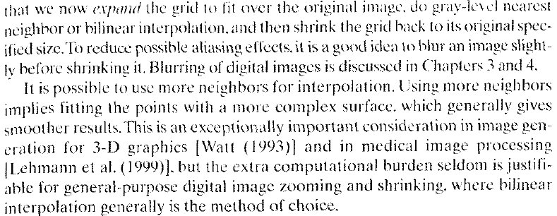
A template matching example
An Image (I)
A Template (T)
Assumption: template and image has no scaling difference, i.e., they have same resolution

Slide 6
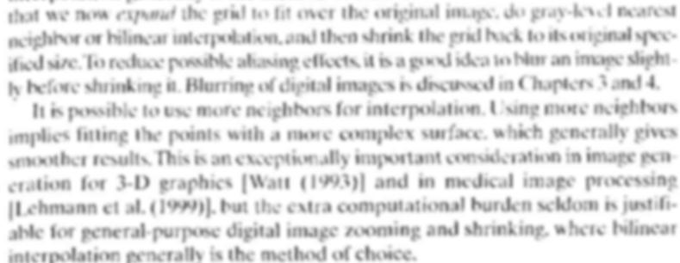
Steps of template matching
Step1: Smooth both the image and the template
Smoothed Template (T)
Smoothed Image (I)

Slide 7
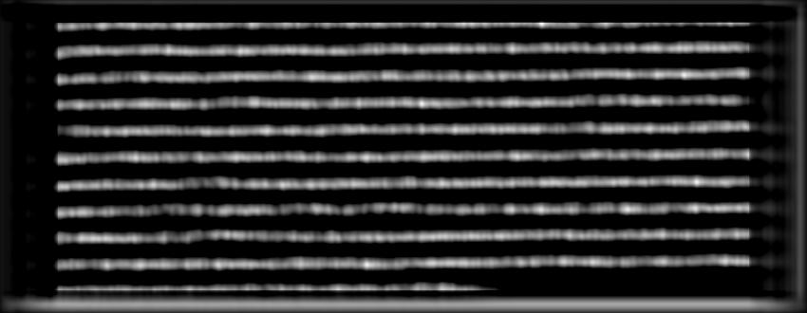
Steps of template matching…
Step 2: Perform normalized cross correlation
Normalized Cross Correlation Image: All values lie between -1 and 1

Slide 8
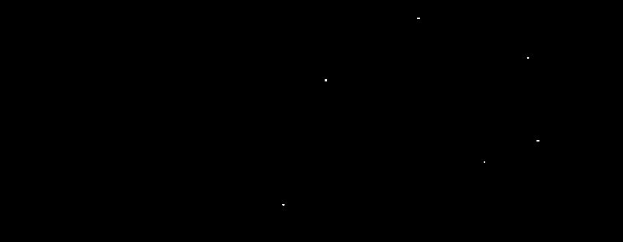
Steps of template matching…
Step 3: Apply a suitable threshold value to the normalized cross correlation image
Location of the white dots are where template is found

Slide 9
Steps of template matching…
Step 4: Draw rectangular boxes on the original image where template is found

Slide 10
Discussion
Choice of threshold value
Increasing threshold value will miss some genuine locations
Decreasing threshold value will bring in false locations
Is there a threshold value that separates false detections and genuine detections?
Even if there is one, how do we choose it?
Typically threshold value is chosen from training cases
If more information is available, it can be chosen applying theory (e.g., Bayes)

Slide 11
Discussion..
What happens if we do not smooth
We will have a hard time finding a threshold value that separates false detections from genuine ones

